Slide 1



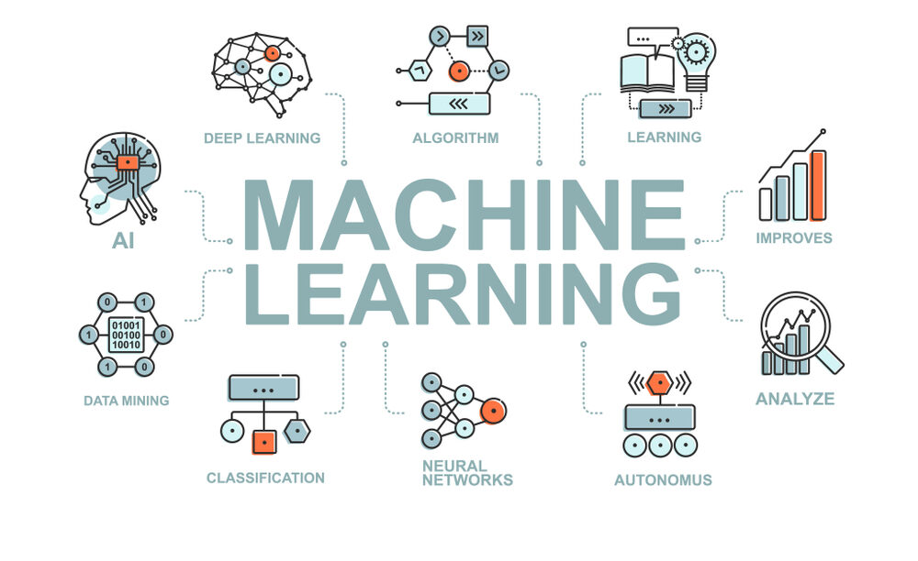
MACHINE LEARNING
introduction to machine learning

Slide 2
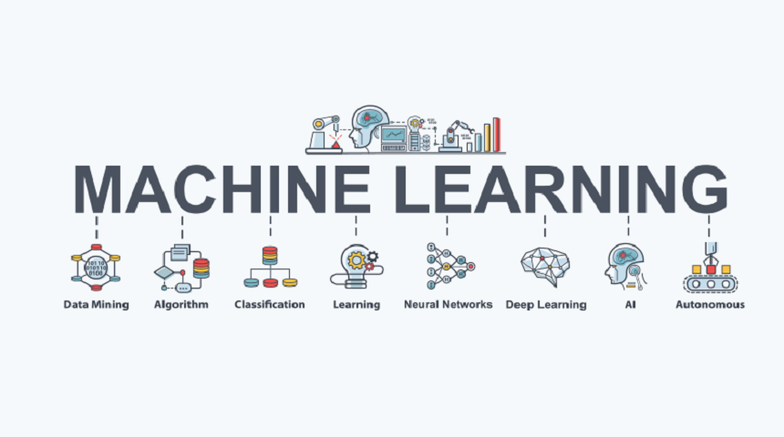
Introduction to Machine learning
What is machine learning?
Machine learning is an application of artificial intelligence (AI) that provides systems with the ability to automatically learn and improve from experience without being explicitly programmed, gradually improving their accuracy.
The primary aim is to allow the computers to learn automatically without human intervention or assistance and adjust actions accordingly.
Machine learning is an important component of the growing field of data science. Through the use of statistical methods, algorithms are trained to make classifications or predictions.
In the past decade, machine learning has given us self-driving cars, practical speech recognition, effective web search etc.
Machine learning is so pervasive today that you probably use it dozens of times a day without knowing it.

Slide 3
Predictive Analytics
Modelling:
Modelling uses machine learning algorithms, in which the machine learns from the data just like humans learn from their experiences.
Let’s go deeper into the types of models that come under machine learning.
Machine learning models can be classified into the following three types based on the task performed and the nature of the output:
Regression: The output variable to be predicted is continuous, e.g. scores of a student.
Classification: The output variable to be predicted is a categorical variable, e.g. classifying incoming emails as spam or ham.
Clustering: No pre-defined notion of a label is allocated to groups/clusters formed, e.g. customer segmentation.

Slide 4
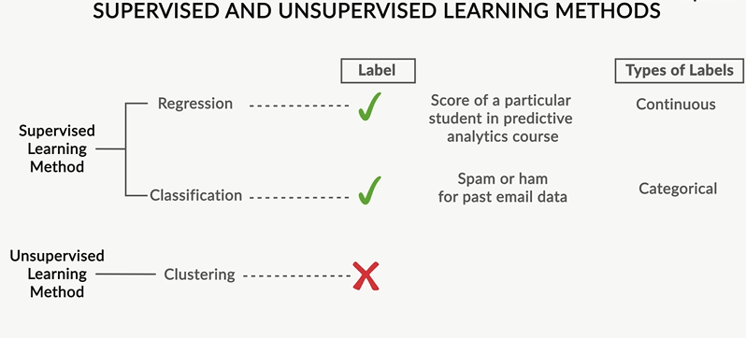
Predictive Analytics
Supervised and unsupervised learning methods:
So you can classify machine learning models into two broad categories:
Supervised learning methods
Past data with labels is used for building the model
Regression and classification algorithms fall under this category
Unsupervised learning methods
No pre-defined labels are assigned to past data
Clustering algorithms fall under this category

Slide 5
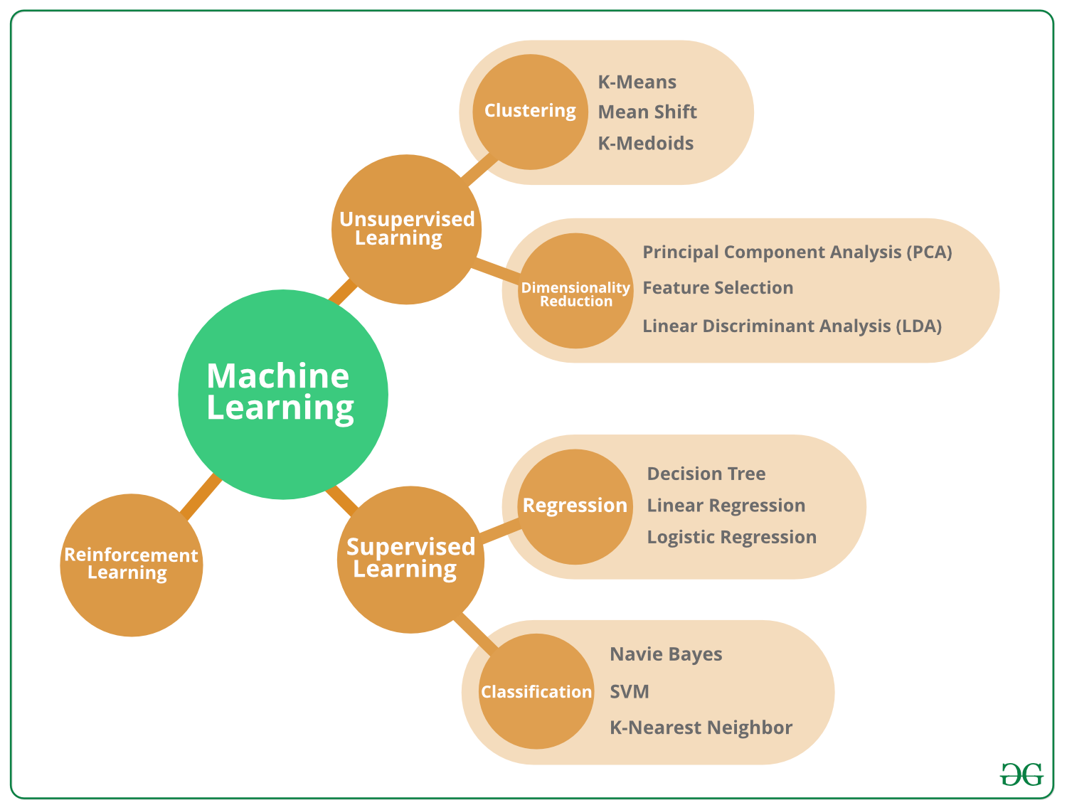
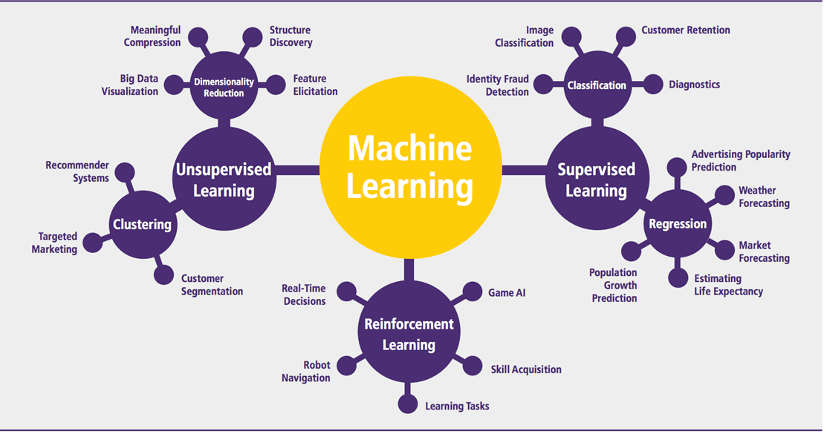
Predictive Analytics

Slide 6
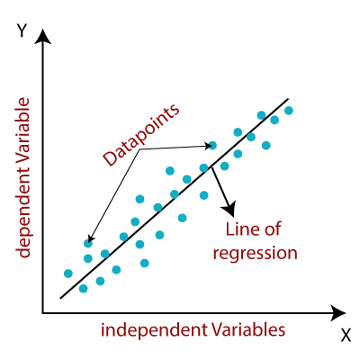
Predictive Analytics
Linear Regression in Machine Learning: Linear regression is one of the easiest and most popular Machine Learning algorithms. It is a statistical method that is used for predictive analysis.
Linear regression makes predictions for continuous/real or numeric variables such as sales, salary, age, product price, etc.
Linear regression algorithm shows a linear relationship between a dependent (y) and one or more independent (y) variables, hence called as linear regression.
The linear regression model provides a sloped straight line representing the relationship between the variables.

Slide 7
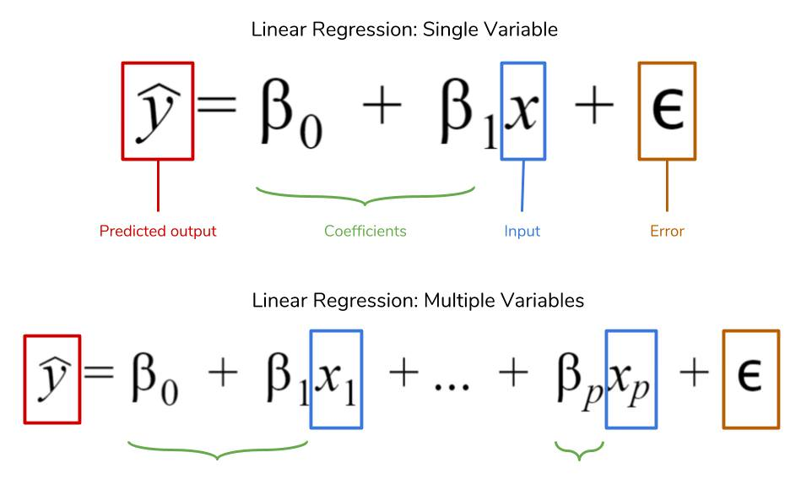
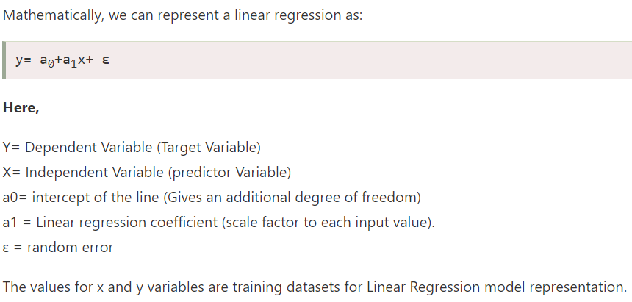
Predictive Analytics

Slide 8
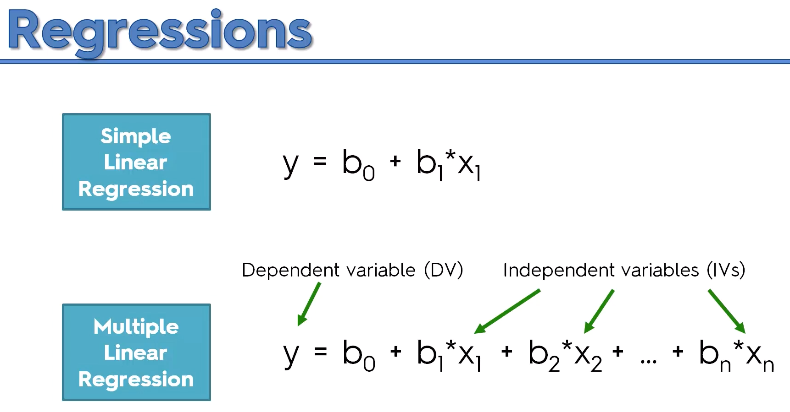
Predictive Analytics
Types of Linear Regression:
Linear regression can be further divided into two types of the algorithm:
Simple Linear Regression:
If a single independent variable is used to predict the value of a numerical dependent variable, then such a Linear Regression algorithm is called Simple Linear Regression.
Multiple Linear regression:
If more than one independent variable is used to predict the value of a numerical dependent variable, then such a Linear Regression algorithm is called Multiple Linear Regression

Slide 9
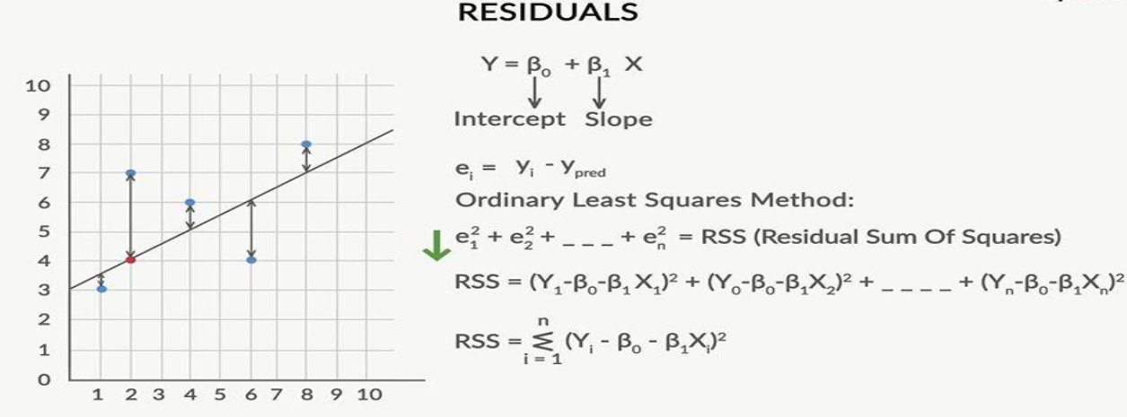
Predictive Analytics
Finding the best fit line:
When working with linear regression, our main goal is to find the best fit line that means the error between predicted values and actual values should be minimized.
The best fit line will have the least error.
The best-fit line is found by minimizing the expression of RSS (Residual Sum of Squares) which is equal to the sum of squares of the residual for each data point in the plot.
Residuals for any data point is found by subtracting predicted value of dependent variable from actual value of dependent variable.

Slide 10
Predictive Analytics
Residuals: The distance between the actual value and predicted values is called residual. If the observed points are far from the regression line, then the residual will be high, and so cost function will high. If the scatter points are close to the regression line, then the residual will be small and hence the cost function.
The strength of the linear regression model can be assessed using metric:
R² or Coefficient of Determination:
Overall, the higher the R-squared, the better the model fits your data.
Mathematically, it is represented as: R² = 1 - (RSS / TSS)
RSS (Residual Sum of Squares): In statistics, it is defined as the total sum of error across the whole sample. It is the measure of the difference between the expected and the actual output. A small RSS indicates a tight fit of the model to the data.
TSS (Total sum of squares): It is the sum of errors of the data points from mean of response variable.

Slide 11
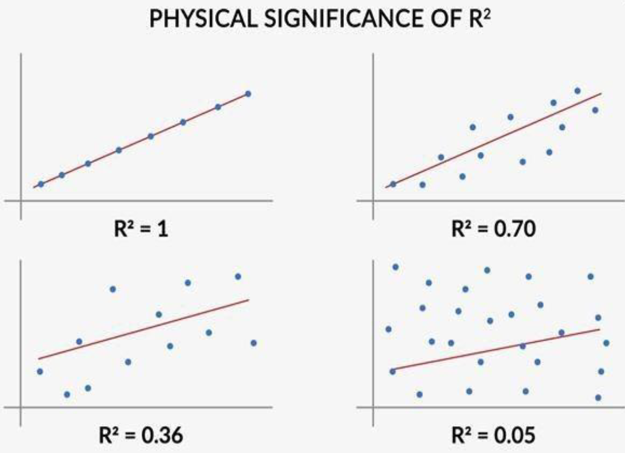
Predictive Analytics
In Graph 1: All the points lie on the line and the R2 value is a perfect 1
In Graph 2: Some points deviate from the line and the error is represented by the lower R2 value of 0.70
In Graph 3: The deviation further increases and the R2 value further goes down to 0.36
In Graph 4: The deviation is further higher with a very low R2 value of 0.05

Slide 12
Predictive Analytics
Applications of Simple Linear Regression:
Marks scored by students based on the number of hours studied (ideally)- Here marks scored in exams are independent and the number of hours studied is independent.
Predicting crop yields based on the amount of rainfall- Yield is a dependent variable while the measure of precipitation is an independent variable.
Predicting the Salary of a person based on years of experience- Therefore, Experience becomes independent while Salary turns into the dependent variable
Advantage of Using Linear Regression:
Linear Regression provides the significance level of each attribute contributing to the prediction of the dependent variable. With this data, we can choose between the variables which are highly contributing/ important variables.

Slide 13
Predictive Analytics
Logistic regression:
Logistic regression is one of the most popular Machine Learning algorithms, which comes under the Supervised Learning technique.
It is used for predicting the categorical dependent variable using a given set of independent variables.
Logistic regression predicts the output of a categorical dependent variable.
Therefore the outcome must be a categorical or discrete value. It can be either Yes or No, 0 or 1, true or False, etc. but instead of giving the exact value as 0 and 1, it gives the probabilistic values which lie between 0 and 1.
Logistic Regression is a significant machine learning algorithm because it can provide probabilities and classify new data using continuous and discrete datasets.

Slide 14

Predictive Analytics
In Logistic regression, instead of fitting a regression line, we fit an "S" shaped logistic function, which predicts two maximum values (0 or 1).
The sigmoid function is a mathematical function used to map the predicted values to probabilities.
It maps any real value into another value within a range of 0 and 1.
Its equation is given by the following expression –

Slide 15
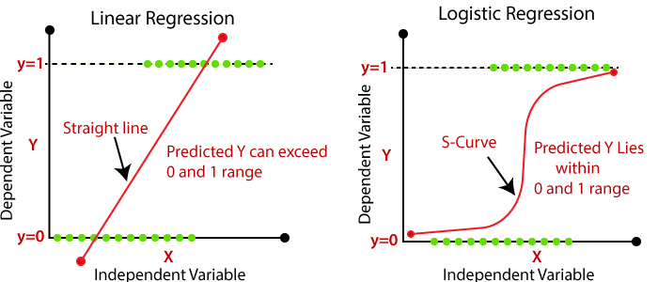
Predictive Analytics
Logistic Function (Sigmoid Function):
The value of the logistic regression must be between 0 and 1, which cannot go beyond this limit, so it forms a curve like the "S" form.
The S-form curve is called the Sigmoid function or the logistic function.
In logistic regression, we use the concept of the threshold value, which defines the probability of either 0 or 1. Such as values above the threshold value tends to 1, and a value below the threshold values tends to 0.

Slide 16
Predictive Analytics
Fitting Logistic Regression to the Training set:
We have well prepared our dataset, and now we will train the dataset using the training set.
For providing training or fitting the model to the training set, we will import the Logistic Regression class of the sklearn library.
After importing the class, we will create a classifier object and use it to fit the model to the logistic regression.
Fitting Logistic Regression to the training set.
Below is the code for it:
from sklearn.linear_model import LogisticRegression
classifier= LogisticRegression(random_state=0)
classifier.fit(x_train, y_train)

Slide 17
Predictive Analytics
Predicting the Test Result:
Our model is well trained on the training set, so we will now predict the result by using test set data.
Below is the code for it:
y_pred= classifier.predict(x_test)
Test Accuracy of the result:
Now we will create the confusion matrix here to check the accuracy of the classification.
To create it, we need to import the confusion_matrix function of the sklearn library.
After importing the function, we will call it using a new variable cm.
Below is the code for it:
from sklearn.metrics import confusion_matrix
cm= confusion_matrix()

Slide 18
Predictive Analytics
Decision Tree Algorithm: Introduction
A decision Tree is one of the easiest and popular classification algorithms to understand and interpret.
A decision Tree is a Supervised learning technique that can be used for both classification and Regression problems, but mostly it is preferred for solving Classification problems.
Classification is a two-step process, the learning step and prediction step, in machine learning.
In the learning step, the model is developed based on given training data.
In the prediction step, the model is used to predict the response for given data.
It is a tree-structured classifier, where internal nodes represent the features of a dataset, branches represent the decision rules and each leaf node represents the outcome.

Slide 19

Predictive Analytics
In a Decision tree, there are two nodes, which are the Decision Node and Leaf Node. Decision nodes are used to make any decision and have multiple branches, whereas Leaf nodes are the output of those decisions and do not contain any further branches.
The goal of using a Decision Tree is to create a training model that can use to predict the class or value of the target variable by learning simple decision rules inferred from prior data(training data).
In Decision Trees, for predicting a class label for a record we start from the root of the tree. We compare the values of the root attribute with the record’s attribute. Based on comparison, we follow the branch corresponding to that value and jump to the next node.

Slide 20
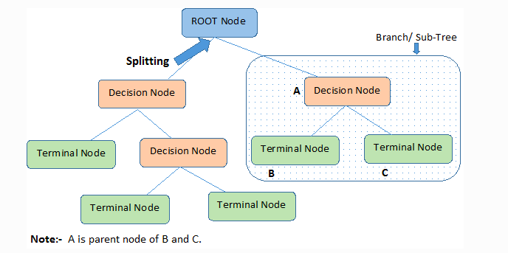
Predictive Analytics
Decision Tree Terminologies:
Root Node: The root node is from where the decision tree starts. It represents the entire dataset, which further gets divided into two or more homogeneous sets.
Leaf Node: Leaf nodes are the final output node, and the tree cannot be segregated further after getting a leaf node.
Splitting: Splitting is the process of dividing the decision node/root node into sub-nodes according to the given conditions.
Branch/Sub Tree: A tree formed by splitting the tree.
Pruning: Pruning is the process of removing unwanted branches from the tree.
Parent/Child node: The root node of the tree is called the parent node, and other nodes are called the child nodes.

Slide 21
Predictive Analytics
How does the Decision Tree algorithm Work?
In a decision tree, for predicting the class of the given dataset, the algorithm starts from the root node of the tree. This algorithm compares the values of root attribute with the record (real dataset) attribute and, based on the comparison, follows the branch and jumps to the next node.
For the next node, the algorithm again compares the attribute value with the other sub-nodes and move further. It continues the process until it reaches the leaf node of the tree.
The complete process can be better understood using the below algorithm:
Step-1: Begin the tree with the root node, which contains the complete dataset.
Step-2: Find the best attribute in the dataset using Attribute Selection Measure (ASM).
Step-3: Divide the root node into subsets that contains possible values for the best attributes.
Step-4: Generate the decision tree node, which contains the best attribute.
Step-5: Recursively make new decision trees using the subsets of the dataset created in step -3.
Continue this process until a stage is reached where you cannot further classify the nodes and called the final node as a leaf node.

Slide 22
Predictive Analytics
Attribute Selection Measures:
While implementing a Decision tree, the main issue arises that how to select the best attribute for the root node and for sub-nodes. So, to solve such problems there is a technique which is called as Attribute selection measure or ASM. By this measurement, we can easily select the best attribute for the nodes of the tree. There is a popular technique for ASM.
Information Gain:
Information gain is the measurement of changes in entropy after the segmentation of a dataset based on an attribute.
It calculates how much information a feature provides us about a class.
According to the value of information gain, we split the node and build the decision tree.
A decision tree algorithm always tries to maximize the value of information gain, and a node/attribute having the highest information gain is split first.

Slide 23
Predictive Analytics
Attribute Selection Measures:
While implementing a Decision tree, the main issue arises that how to select the best attribute for the root node and for sub-nodes. So, to solve such problems there is a technique which is called as ASM.
By this measurement, we can easily select the best attribute for the nodes of the tree.
Entropy: Entropy is a metric to measure the impurity in a given attribute. It specifies randomness in data.
Entropy(s)= -P(yes)log2 P(yes)- P(no) log2 P(no)
Information Gain:
Information gain is the measurement of changes in entropy after the segmentation of a dataset based on an attribute.
It calculates how much information a feature provides us about a class. According to the value of information gain, we split the node and build the decision tree.
A decision tree algorithm always tries to maximize the value of information gain, and a node/attribute having the highest information gain is split first.
Information Gain= Entropy(S)- [(Weighted Avg) *Entropy(each feature)

Slide 24
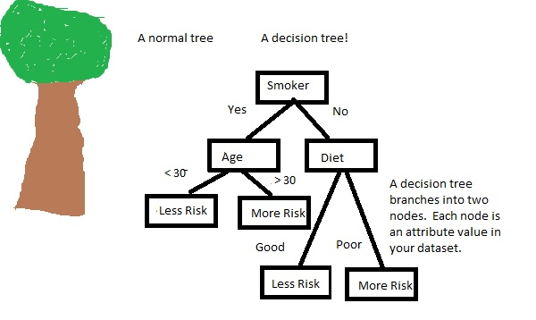
Predictive Analytics
Python Implementation of Decision Tree:
Steps which are given below:
Data Pre-processing step.
Fitting a Decision-Tree algorithm to the Training set.
Predicting the test result.
Test accuracy of the result(Creation of Confusion matrix).

Slide 25
Predictive Analytics
Fitting a Decision-Tree algorithm to the Training set: For this, we will import the DecisionTreeClassifier class from sklearn.tree library.
Below is the code for it:
From sklearn.tree import DecisionTreeClassifier
classifier= DecisionTreeClassifier(criterion='entropy', random_state=0)
classifier.fit(x_train, y_train)
In the above code, we have created a classifier object, in which we have passed two main parameters;
"criterion='entropy': Criterion is used to measure the quality of split, which is calculated by information gain given by entropy.
random_state=0": For generating the random states.

Slide 26
Predictive Analytics
Predicting the test result:
Now we will predict the test set result. We will create a new prediction vector y_pred.
Below is the code for it:
y_pred= classifier.predict(x_test)
Test accuracy of the result (Creation of Confusion matrix):
Below is the code for it:
from sklearn.metrics import confusion_matrix
cm= confusion_matrix(y_test, y_pred)

Slide 27
Predictive Analytics
Advantages of the Decision Tree:
It is simple to understand as it follows the same process which a human follow while making any decision in real-life.
It can be very useful for solving decision-related problems.
It helps to think about all the possible outcomes for a problem.
There is less requirement of data cleaning compared to other algorithms.
Disadvantages of the Decision Tree:
The decision tree contains lots of layers, which makes it complex.
It may have an overfitting issue, which can be resolved using the Random Forest algorithm.
For more class labels, the computational complexity of the decision tree may increase.

Slide 28
Predictive Analytics
Naïve Bayes Classifier Algorithm:
Naïve Bayes algorithm is a supervised learning algorithm, which is based on Bayes theorem and used for solving classification problems.
It is mainly used in text classification that includes a high-dimensional training dataset.
Naïve Bayes Classifier is one of the simple and most effective Classification algorithms which helps in building the fast machine learning models that can make quick predictions.
It is a probabilistic classifier, which means it predicts on the basis of the probability of an object.
Some popular examples of Naïve Bayes Algorithm are spam filtration, Sentimental analysis, and classifying articles.

Slide 29
Predictive Analytics
Why is it called Naïve Bayes?
The Naïve Bayes algorithm is comprised of two words Naïve and Bayes.
Naïve: It is called Naïve because it assumes that the occurrence of a certain feature is independent of the occurrence of other features. Such as if the fruit is identified on the basis of color, shape, and taste, then red, spherical, and sweet fruit is recognized as an apple. Hence each feature individually contributes to identifying that it is an apple without depending on each other.
Bayes: It is called Bayes because it depends on the principle of the naive Bayes theorem.
Bayes' Theorem:
Bayes' theorem is also known as Bayes' Rule or Bayes' law, which is used to determine the probability of a hypothesis with prior knowledge. It depends on conditional probability.

Slide 30
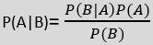
Predictive Analytics
Probability is the chance of occurrence of an event, it can be defined as a ratio of the number of desired outcomes to the number of total possible outcomes.
It is denoted as p(E), indicating the probability of an event E. In the numerator we have the number of favorable outcomes for this event E and in the denominator, we have the total number of outcomes corresponding to our data.
Bayes Theorem : Given Probability of an event B occurring given event A has already occurred and individual Probabilities of A and B we can find the reverse conditional probability P(A|B) by using what is called Bayes Theorem .
Conditional probability: 𝑷(𝑨|𝑩)=𝑷(𝑨∩𝑩)/𝑷(𝑩) P (A|B) is the probability of event A occurring, given that event B occurs.

Slide 31
Predictive Analytics
Types of Naïve Bayes Model:
There are three types of Naive Bayes Model, which are given below:
Gaussian: The Gaussian model assumes that features follow a normal distribution. This means if predictors take continuous values instead of discrete, then the model assumes that these values are sampled from the Gaussian distribution.
Multinomial: The Multinomial Naïve Bayes classifier is used when the data is multinomial distributed. It is primarily used for document classification problems, it means a particular document belongs to which category such as Sports, Politics, education, etc.
The classifier uses the frequency of words for the predictors.
Bernoulli: The Bernoulli classifier works similar to the Multinomial classifier, but the predictor variables are the independent Booleans variables. Such as if a particular word is present or not in a document. This model is also famous for document classification tasks.

Slide 32
Predictive Analytics
Python Implementation :
Steps to implement:
Data Pre-processing step
Fitting Naive Bayes to the Training set
Predicting the test result
Test accuracy of the result(Creation of Confusion matrix
Applications of Naïve Bayes Classifier:
It is used for Credit Scoring.
It is used in medical data classification.
It can be used in real-time predictions because Naïve Bayes Classifier is an eager learner.
It is used in Text classification such as Spam filtering and Sentiment analysis.

Slide 33
Predictive Analytics
Fitting Naive Bayes to the Training Set:
After the pre-processing step, now we will fit the Naive Bayes model into the Training set.
Below is the code for it:
Fitting Naive Bayes to the Training set.
from sklearn.naive_bayes import GaussianNB
classifier = GaussianNB()
classifier.fit(x_train, y_train)
In the above code, we have used the GaussianNB classifier to fit it to the training dataset. We can also use other classifiers as per our requirements.

Slide 34
Predictive Analytics
Prediction of the test set result:
Now we will predict the test set result. For this, we will create a new predictor variable y_pred, and will use the predict function to make the predictions.
Predicting the Test set results.
y_pred = classifier.predict(x_test)
Creating Confusion Matrix:
Now we will check the accuracy of the Naive Bayes classifier using the Confusion matrix.
Below is the code for it:
Making the Confusion Matrix
from sklearn.metrics import confusion_matrix
cm = confusion_matrix(y_test, y_pred)

Slide 35
Predictive Analytics
Advantages of Naïve Bayes Classifier:
Naïve Bayes is one of the fast and easy ML algorithms to predict a class of datasets.
It can be used for Binary as well as Multi-class Classifications.
It performs well in Multi-class predictions as compared to the other Algorithms.
It is the most popular choice for text classification problems.
Disadvantages of Naïve Bayes Classifier:
Naive Bayes assumes that all features are independent or unrelated, so it cannot learn the relationship between features.

Slide 36
Predictive Analytics
Random Forest Algorithm:
Random Forest is a popular machine learning algorithm that belongs to the supervised learning technique.
It can be used for both Classification and Regression problems in ML. It is based on the concept of ensemble learning, which is a process of combining multiple classifiers to solve a complex problem and to improve the performance of the model.
As the name suggests, "Random Forest is a classifier that contains a number of decision trees on various subsets of the given dataset and takes the average to improve the predictive accuracy of that dataset."
Before understanding the working of the random forest we must look into the ensemble technique. Ensemble simply means combining multiple models. Thus a collection of models is used to make predictions rather than an individual model.

Slide 37
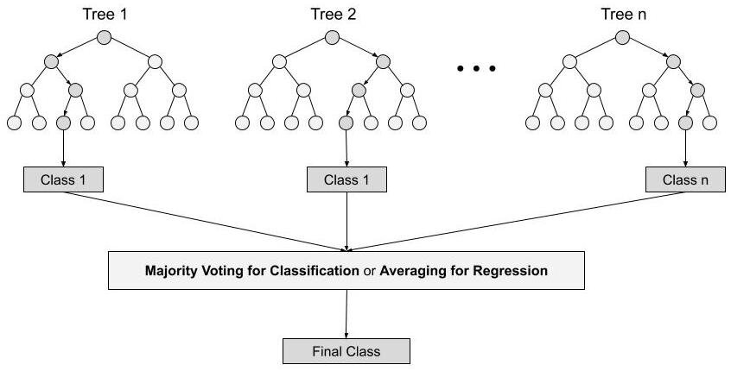
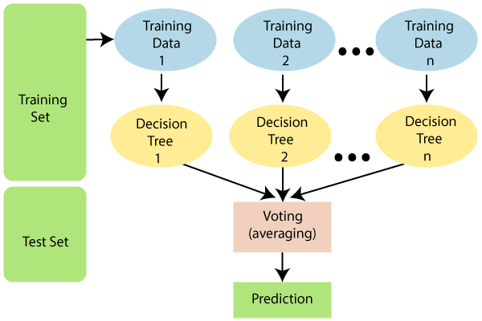
Predictive Analytics

Slide 38
Predictive Analytics
Instead of relying on one decision tree, the random forest takes the prediction from each tree and based on the majority votes of predictions, and it predicts the final output.
It builds decision trees on different samples and takes their majority vote for classification and average in case of regression. One of the most important features of the Random Forest Algorithm is that it can handle the data set containing continuous variables as in the case of regression and categorical variables as in the case of classification.
It performs better results for classification problems.
The greater number of trees in the forest leads to higher accuracy and prevents the problem of overfitting.
Why use Random Forest?
It takes less training time as compared to other algorithms.
It predicts output with high accuracy, even for the large dataset it runs efficiently. It can also maintain accuracy when a large proportion of data is missing.

Slide 39
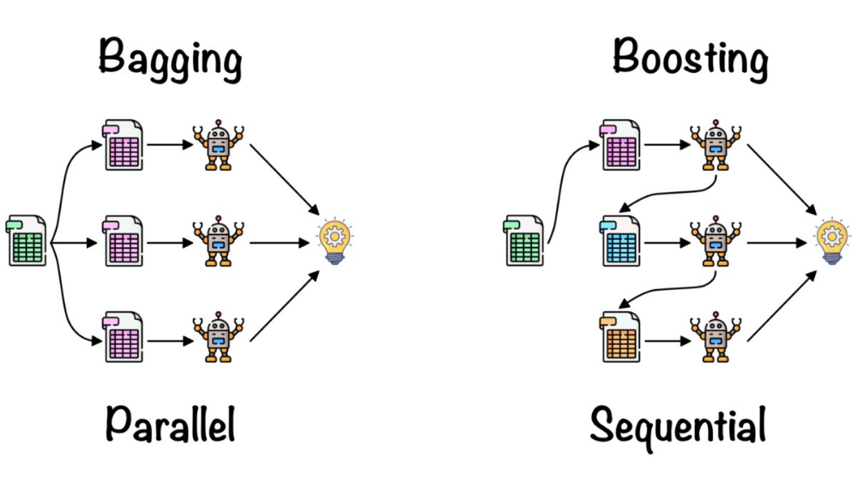
Predictive Analytics
Ensemble uses two types of methods:
1. Bagging– It creates a different training subset from sample training data with replacement & the final output is based on majority voting.
For example, Random Forest.
2. Boosting– It combines weak learners into strong learners by creating sequential models such that the final model has the highest accuracy.
For example, ADA BOOST, XG BOOST

Slide 40
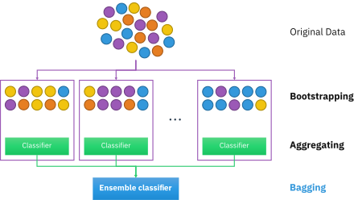
Predictive Analytics
Bagging:
Bagging, also known as Bootstrap Aggregation is the ensemble technique used by random forests. Bagging chooses a random sample from the data set.
Hence each model is generated from the samples (Bootstrap Samples) provided by the Original Data with replacement known as row sampling.
This step of row sampling with replacement is called bootstrap. Now each model is trained independently which generates results.
The final output is based on majority voting after combining the results of all models. This step which involves combining all the results and generating output based on majority voting is known as aggregation.

Slide 41
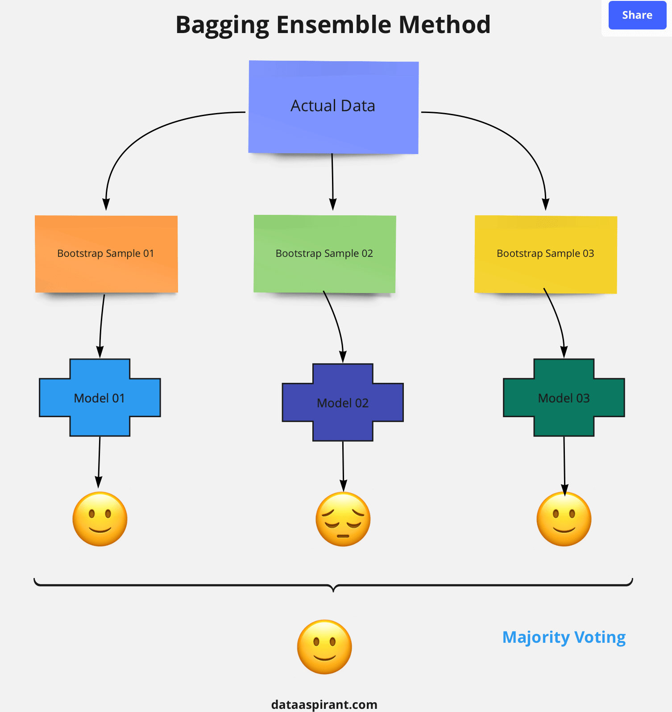
Predictive Analytics
Steps involved in random forest algorithm:
Step 1: In Random forest n number of random records are taken from the data set having k number of records.
Step 2: Individual decision trees are constructed for each sample.
Step 3: Each decision tree will generate an output.
Step 4: Final output is considered based on Majority Voting or Averaging for Classification and regression respectively.

Slide 42
Predictive Analytics
Decision trees
Random Forest
Decision trees normally suffer from the problem of overfitting if it’s allowed to grow without any control.
A single decision tree is faster in computation.
When a data set with features is taken as input by a decision tree it will formulate some set of rules to do prediction.
Random forests are created from subsets of data and the final output is based on average or majority ranking and hence the problem of overfitting is taken care of.
It is comparatively slower.
Random forest randomly selects observations, builds a decision tree and the average result is taken. It doesn’t use any set of formulas.

Slide 43
Predictive Analytics
Important Hyperparameters:
Hyperparameters are used in random forests to either enhance the performance and predictive power of models or to make the model faster.
Following hyperparameters increases the predictive power:
1. n_estimators– number of trees the algorithm builds before averaging the predictions.
2. max_features– maximum number of features random forest considers splitting a node.
3. mini_sample_leaf– determines the minimum number of leaves required to split an internal node.
Following hyperparameters increases the speed:
1. n_jobs– it tells the engine how many processors it is allowed to use. If the value is 1, it can use only one processor but if the value is -1 there is no limit.
2. random_state– controls randomness of the sample. The model will always produce the same results if it has a definite value of random state and if it has been given the same hyperparameters and the same training data.

Slide 44
Predictive Analytics
Fitting the Random Forest algorithm to the training set:
Now we will fit the Random forest algorithm to the training set. To fit it, we will import the RandomForestClassifier class from the sklearn.ensemble library.
The code is given below:
from sklearn.ensemble import RandomForestClassifier
classifier= RandomForestClassifier(n_estimators= 10, criterion="entropy")
classifier.fit(x_train, y_train)
In the above code, the classifier object takes below parameters:
n_estimators= The required number of trees in the Random Forest. The default value is 10. We can choose any number but need to take care of the overfitting issue.
criterion= It is a function to analyze the accuracy of the split. Here we have taken "entropy" for the information gain.

Slide 45
Predictive Analytics
Predicting the Test Set result:
Since our model is fitted to the training set, so now we can predict the test result. For prediction, we will create a new prediction vector y_pred.
Below is the code for it:
y_pred= classifier.predict(x_test)
Creating the Confusion Matrix:
Now we will create the confusion matrix to determine the correct and incorrect predictions.
Below is the code for it:
from sklearn.metrics import confusion_matrix
cm= confusion_matrix(y_test, y_pred)

Slide 46
Predictive Analytics
Applications of Random Forest:
There are mainly four sectors where Random forest is mostly used:
Banking: The banking sector mostly uses this algorithm for the identification of loan risk.
Medicine: With the help of this algorithm, disease trends and risks of the disease can be identified.
Land Use: We can identify the areas of similar land use by this algorithm.
Marketing: Marketing trends can be identified using this algorithm.
Advantages of Random Forest:
Random Forest is capable of performing both Classification and Regression tasks.
It is capable of handling large datasets with high dimensionality.
It enhances the accuracy of the model and prevents the overfitting issue.
Disadvantages of Random Forest:
Although random forest can be used for both classification and regression tasks, it is not more suitable for Regression tasks

Slide 47
Predictive Analytics
Boosting:
Boosting is an ensemble learning technique to build a strong classifier from several weak classifiers in series.
Below are the few types of boosting algorithms:
AdaBoost (Adaptive Boosting)
Gradient boosting
XGBoost
Catboost

Slide 48
Predictive Analytics
AdaBoost: Ada boost is short for Adaptive Boosting. AdaBoost was the first successful boosting algorithm developed for binary classification. Also, it is the best starting point for understanding boosting algorithms. The algorithm that uses the boosting technique and is more commonly known as AdaBoost.It is sensitive to noisy data and outliers.
AdaBoost uses multiple iterations to generate a single composite strong learner. It creates a strong learner by iteratively adding weak learners. . As you can see the final model can classify all the points correctly. This final model is known as a strong learner.
Let’s once again see all the steps taken in AdaBoost.
Build a model and make predictions.
Assign higher weights to miss-classified points.
Build next model.
Repeat steps 3 and 4.
Make a final model using the weighted average of individual models.

Slide 49
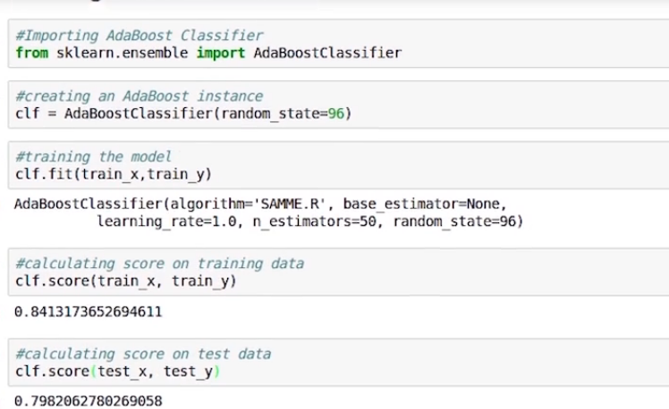
Predictive Analytics
Implementation:
Now we will see the implementation of the AdaBoost Algorithm.
import the AdaBoostClassifier from sklearn. ensemble and create an instance of the same.
Then we used train_x and train_y and train by fitting the classifier.
At the end, we can check the accuracy score with the help of confusion matrix.

Slide 50
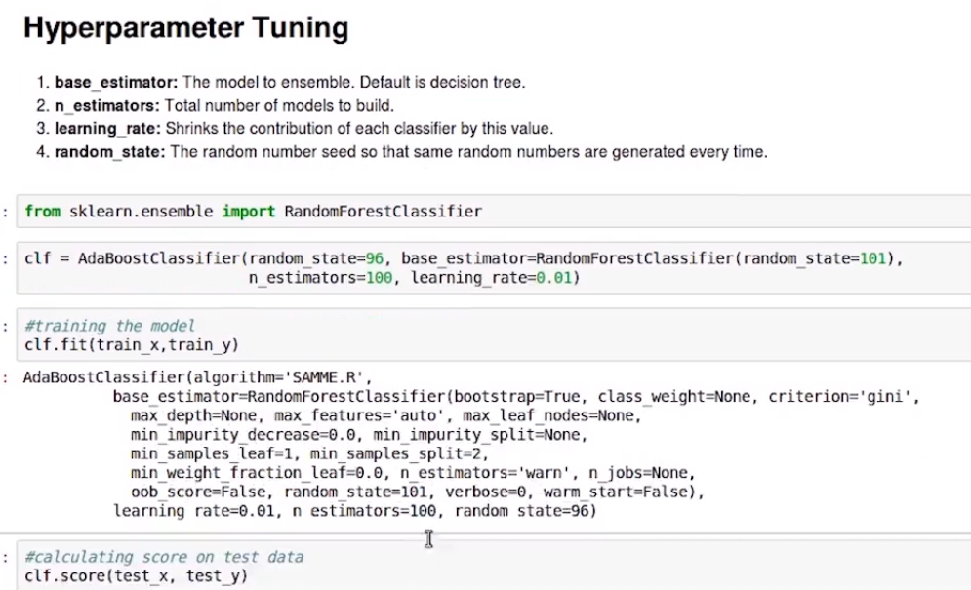
Predictive Analytics
Hyper-parameter tuning:
Let’s have a look at the hyper-parameters of the AdaBoost model. Hyper-parameters are the values that we give to a model before we start the modelling process.
base_estimator: The model to the ensemble, the default is a decision tree.
n_estimators: Number of models to be built.
learning_rate: shrinks the contribution of each classifier by this value.

Slide 51
Predictive Analytics
Gradient boosting algorithm:
GBM is one of the most powerful algorithms in the field of machine learning. As we know that the errors in machine learning algorithms are broadly classified into two categories i.e. Bias Error and Variance Error. As gradient boosting is one of the boosting algorithms it is used to minimize bias error of the model.
Gradient boosting is one of the most powerful techniques for building predictive models, and it is called a Generalization of AdaBoost.
The main objective of Gradient Boost is to minimize the loss function by adding weak learners using a gradient descent optimization algorithm.
Gradient boosting algorithm can be used for predicting not only continuous target variable (as a Regressor) but also categorical target variable (as a Classifier).

Slide 52
Predictive Analytics
Gradient Boost has three main components:
Loss Function:
The role of the loss function is to estimate how best is the model in making predictions with the given data.
Weak Learner:
The weak learners are mostly decision trees, but other models can be used in GBM.
Additive Model:
It is an iterative and sequential process in adding the decision trees one step at a time. Each iteration should reduce the value of loss function. A fixed number of trees are added, or training stops once loss reaches an acceptable level or no longer improves on an external validation dataset.
Unlike, Adaboosting algorithm, the base estimator in the gradient boosting algorithm cannot be mentioned by us. The base estimator for the Gradient Boost algorithm is fixed and i.e. Decision Stump. Like, AdaBoost, we can tune the n_estimator of the gradient boosting algorithm. However, if we do not mention the value of n_estimator, the default value of n_estimator for this algorithm is 100.

Slide 53
Predictive Analytics
XGBoost Algorithm for Classification and Regression:
It is also known as “Extreme Gradient Boosting”.
XGboost is the most widely used algorithm in machine learning, whether the problem is a classification or a regression problem. It is known for its good performance as compared to all other ML algorithms.
XGBoost is an extension to gradient boosted decision trees (GBM) and is specially designed to improve speed and performance.
“It is the execution of gradient boosted decision trees that are designed for high speed and performance.”

Slide 54
Predictive Analytics
What is the working behind XGBoost?
Boosting is nothing but ensemble techniques where previous model errors are resolved in the new models. These models are added straight until no other improvement is seen. One of the best examples of such an algorithm is the AdaBoost algorithm.
Gradient boosting is a method where the new models are created that computes the error in the previous model and then leftover is added to make the final prediction.
It uses a gradient descent algorithm that is the reason it is called a “Gradient Boosting Algorithm”. Weather classification or regression methods are supported for both types of predictive modelling problems.
XGBoost is an extension to gradient boosted decision trees (GBM) and specially designed to improve speed and performance.

Slide 55
Predictive Analytics
Let’s understand the reason behind the good performance of XGboost -
Regularization:
This is considered to be a dominant factor of the algorithm. Regularization is a technique that is used to get rid of the overfitting of the model.
Cross-Validation:
We use cross-validation by importing the function from sklearn but XGboost is enabled with an inbuilt CV function.
Missing Value:
It is designed in such a way that it can handle missing values. It finds out the trends in the missing values and apprehends them.
Flexibility:
It gives support to objective functions. They are the function used to evaluate the performance of the model and also it can handle the user-defined validation metrics.

Slide 56
Predictive Analytics
Fitting XGBoost to the training data.
The code is given below:
import xgboost
xgbmy_model = xgb.XGBClassifier()
my_model.fit(X_train, y_train)
Predicting the Test set results
y_pred = my_model.predict(X_test)
Making the Confusion Matrix
from sklearn.metrics import confusion_matrix
cm = confusion_matrix(y_test, y_pred)

Slide 57
Predictive Analytics
Cat Boost:
“Cat Boost” name comes from two words “Category” and “Boosting”.
What is Cat Boost?
Cat Boost is a recently open-sourced machine learning algorithm from Yandex. It can easily integrate with deep learning frameworks like Google’s TensorFlow and Apple’s Core ML.
To top it up, it provides best-in-class accuracy.
“Boost” comes from gradient boosting machine learning algorithm as this library is based on gradient boosting library. Gradient boosting is a powerful machine learning algorithm that is widely applied to multiple types of business challenges like fraud detection, recommendation items, forecasting.
It can also return very good results with relatively less data, unlike DL models that need to learn from a massive amount of data.
As discussed, the library works well with multiple Categories of data, such as audio, text, image including historical data.

Slide 58
Predictive Analytics
The Cat Boost library can be used to solve both classification and regression challenges.
For classification, you can use “CatBoostClassifier” and for regression, “CatBoostRegressor“.
The code is given below:
model = CatBoostClassifier(iterations=50)
fit the model with the training data
model.fit(train_x,train_y,cat_features = categorical_var,plot=False)
predict the target on the test dataset
predict_test = model.predict(test_x)
Accuracy Score on test dataset
accuracy_test = accuracy_score(test_y,predict_test)

Slide 59
Predictive Analytics
Advantages of Cat Boost Library:
Performance: Cat Boost provides state of the art results and it is competitive with any leading machine learning algorithm on the performance front.
Handling Categorical features automatically: We can use Cat Boost without any explicit pre-processing to convert categories into numbers. Cat Boost converts categorical values into numbers using various statistics on combinations of categorical features and combinations of categorical and numerical features.
Robust: It reduces the need for extensive hyper-parameter tuning and lower the chances of overfitting also which leads to more generalized models. Although, Cat Boost has multiple parameters to tune and it contains parameters like the number of trees, learning rate, regularization, tree depth, fold size, bagging temperature and others.

Slide 60
Predictive Analytics
K Nearest Neighbor : Algorithm falls under the Supervised Learning category and is used for classification (most commonly) and regression. It is a versatile algorithm also used for imputing missing values and resampling datasets.
As the name (K Nearest neighbor) it considers K Nearest Neighbor's (Data points) to predict the class or continuous value for the new Datapoint.
The algorithm’s learning is: Lazy Learning
Model is not learned using training data prior and the learning process is postponed to a time when prediction is requested on the new instance.
It is also called a lazy learner algorithm because it does not learn from the training set immediately instead it stores the dataset and at the time of classification, it performs an action on the dataset

Slide 61
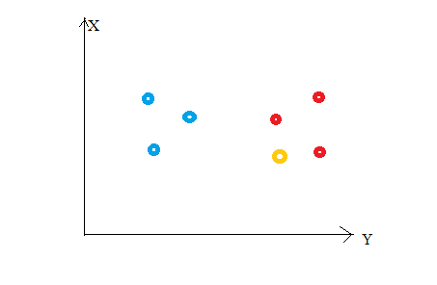
Predictive Analytics
Principle: we have a total of 6 data points (3 red and 3 blue). Red data points belong to ‘class1’ and blue data points belong to ‘class2’. And yellow data point in a feature space represents the new point for which a class is to be predicted.
Obviously, we say it belongs to ‘class1’ (red points).
Because its nearest neighbors belong to that class!
Yes, this is the principle behind K Nearest.
Neighbors. Here, nearest neighbors are those data points that have minimum distance in feature space from our new data point. And K is the number of such data points we consider in our implementation of the algorithm.
Therefore, distance metric and K value are two important considerations while using the KNN algorithm.

Slide 62
Predictive Analytics
Euclidean distance: it is the most popular distance metric.
For predicting class/ continuous value for a new data point, it considers all the data points in the training dataset.
Finds new data point’s ‘K’ Nearest Neighbors (Data points) from feature space and their class labels or continuous values.
For classification: A class label assigned to the majority of K Nearest Neighbors from the training dataset is considered as a predicted class for the new data point.
For regression: Mean or median of continuous values assigned to K Nearest Neighbors from training dataset is a predicted continuous value for our new data point
Model Representation:
Here, we do not learn weights and store them, instead, the entire training dataset is stored in the memory. Therefore, model representation for KNN is the entire training dataset.

Slide 63
Predictive Analytics
How to choose the value for K?
K is a crucial parameter in the KNN algorithm.
Using error curves.
Also, domain knowledge is very useful in choosing the K value.
K value should be odd while considering binary(two-class) classification.
At low K values, there is overfitting of data/high variance. Therefore, test error is high and train error is low. At K=1 in train data, the error is always zero, because the nearest neighbor to that point is that point itself.
Therefore, though training error is low test error is high at lower K values. This is called overfitting. As we increase the value for K, the test error is reduced.

Slide 64
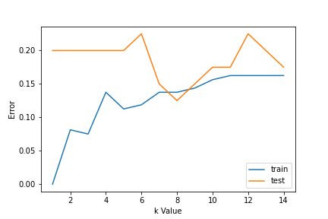
Predictive Analytics
How to choose the value for K?
But after a certain K value, bias/ underfitting is introduced and train error goes high.
So, we can say initially test data error is high (due to variance) then it goes low and stabilizes and with further increase in K value, it again increases (due to bias).
The K value when test error stabilizes and is low is considered as optimal value for K.
From the error curve, we can choose K=8 for our KNN algorithm implementation.

Slide 65
Predictive Analytics
K-NN algorithm stores all the available data and classifies a new data point based on the similarity.
This means when new data appears then it can be easily classified into a good suite category by using K- NN algorithm.
Step-1: Select the number K of the neighbors.
Step-2: Calculate the Euclidean distance of K number of neighbors.
Step-3: Take the K nearest neighbors as per the calculated Euclidean distance.
Step-4: Among these k neighbors, count the number of the data points in each category.
Step-5: Assign the new data points to that category for which the number of neighbors is maximum.
Step-6: Our model is ready.

Slide 66
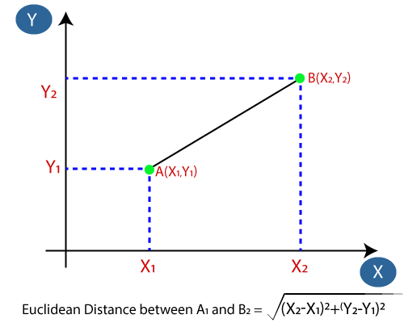
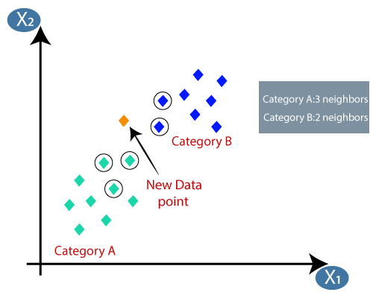
Predictive Analytics

Slide 67
Predictive Analytics
Advantages of KNN Algorithm:
It is simple to implement.
It is robust to the noisy training data.
It can be more effective if the training data is large.
Disadvantages of KNN Algorithm:
Always needs to determine the value of K which may be complex some time.
The computation cost is high because of calculating the distance between the data points for all the training samples.

Slide 68

Predictive Analytics
Introduction to SVM:
Support vector machines (SVMs) are powerful yet flexible supervised machine learning algorithms that are used both for classification and regression.
But generally, they are used in classification problems.
The goal of the SVM algorithm is to create the best line or decision boundary that can segregate n-dimensional space into classes so that we can easily put the new data point in the correct category in the future.

Slide 69
Predictive Analytics
The followings are important concepts in SVM :
Support Vectors − Datapoints that are closest to the hyperplane are called support vectors. A separating line will be defined with the help of these data points.
Hyperplane − As we can see in the above diagram, it is a decision plane or space which is divided between a set of objects having different classes. SVM chooses the extreme points/vectors that help in creating the hyperplane. These extreme cases are called support vectors, and hence algorithm is termed a Support Vector Machine.
Margin − It may be defined as the gap between two lines on the closet data points of different classes. It can be calculated as the perpendicular distance from the line to the support vectors. A large margin is considered as a good margin and a small margin is considered as a bad margin.
The goal of SVM is to divide the datasets into classes to find a maximum marginal hyperplane (MMH).

Slide 70
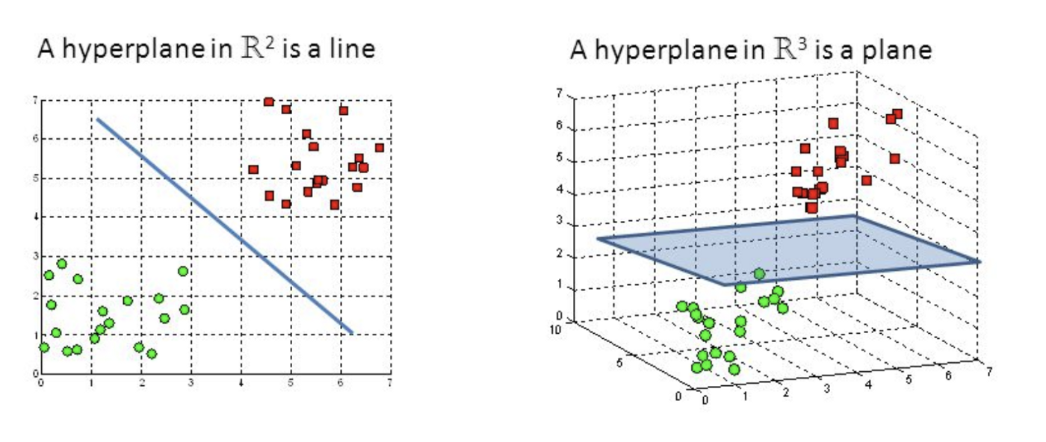
Predictive Analytics
The main goal of SVM is to divide the datasets into classes to find a maximum marginal hyperplane.
it can be done in the following two steps.
First, SVM will generate hyperplanes iteratively that segregates the classes in the best way.
Then, it will choose the hyperplane that separates the classes correctly.
Hyperplanes are decision boundaries that help classify the data points. Data points falling on either side of the hyperplane can be attributed to different classes.

Slide 71
Predictive Analytics
Fitting the SVM classifier to the training set:
Now the training set will be fitted to the SVM classifier. To create the SVM classifier, we will import SVC class from Sklearn.svm library.
Below is the code for it:
from sklearn.svm import SVC
classifier = SVC(kernel=‘linear’, random_state=0)
classifier.fit(x_train, y_train)
In the above code, we have used kernel='linear', as here we are creating SVM for linearly separable data. However, we can change it for non-linear data. And then we fitted the classifier to the training dataset(x_train, y_train)

Slide 72
Predictive Analytics
Predicting the test set result:
Now, we will predict the output for test set. For this, we will create a new vector y_pred.
Below is the code for it:
y_pred= classifier.predict(x_test)
Creating the Confusion matrix:
To create the confusion matrix, we need to import the confusion_matrix function of the sklearn library. After importing the function, we will call it using a new variable cm.
The function takes two parameters, mainly y_true( the actual values) and y_pred (the targeted value return by the classifier).
Below is the code for it:
cm= confusion_matrix(y_test, y_pred)

Slide 73
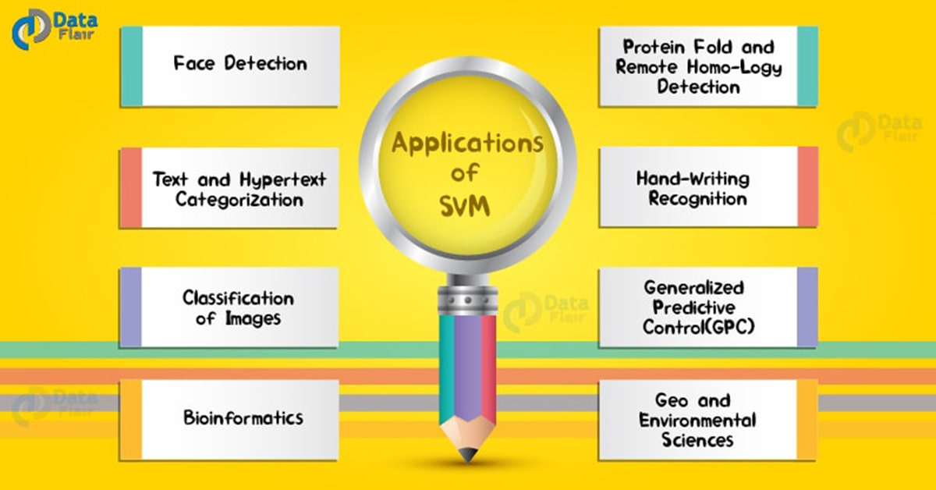
Predictive Analytics

Slide 74
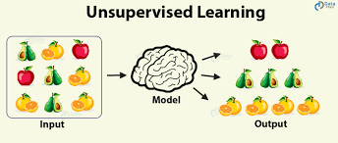
Un – supervised learning
Unsupervised learning:
In supervised learning, we make use of training data set and feed to model to learn and use unseen data points to predict with the help of a trained model. But, in unsupervised learning, the data is unlabeled.
Unsupervised learning uses machine learning algorithms to analyze and cluster unlabeled datasets.
These algorithms discover hidden patterns or data groupings without the need for human intervention.
Its ability to discover similarities and differences in information make it the ideal solution for exploratory data analysis, customer segmentation, and image recognition.

Slide 75
Un – supervised learning
Clustering – The main objective is to discover interesting patterns in the data. E.g. (clusters or subgroups in the data), The two most commonly used clustering algorithms are k- means and hierarchical.
Cluster analysis, or clustering, is an unsupervised machine learning task. It involves automatically discovering natural grouping in data. Unlike supervised learning (like predictive modelling), clustering algorithms only interpret the input data and find natural groups or clusters in feature space.
In clustering, we group the data points into different categories based on the given set of attributes. There are no dependent and independent variables.
The cluster may have a center (the centroid) that is a sample or a point feature space and may have a boundary or extent.
There are different types of clustering algorithms. Here algorithms use similarity or distance measures between examples in the feature space in an effort to discover dense regions of observations.

Slide 76
Un – supervised learning
Clustering works: it groups the objects based on their similarity or closeness to each other. clustering works on the basis of grouping the observations which are the most similar to each other.
in simple terms, the algorithm needs to find data points whose values are similar to each other and therefore these points would then belong to the same cluster. The method in which any clustering algorithm goes about doing that is through the method of finding something called a “distance measure”.
K-Means Clustering:
K-Means Clustering which groups the unlabeled dataset into different clusters. Here K defines the number of pre-defined clusters that need to be created in the process, as if K=2, there will be two clusters, and for K=3, there will be three clusters, and so on.
It is an iterative algorithm that divides the unlabeled dataset into k different clusters in such a way that each dataset belongs to only one group that has similar properties.
The distance measure that is used in K-means clustering is called the Euclidean Distance measure.

Slide 77
Un – supervised learning
Applications of Clustering:
Below are some commonly known applications of clustering techniques in Machine Learning:
In Identification of Cancer Cells: The clustering algorithms are widely used for the identification of cancerous cells. It divides the cancerous and non-cancerous data sets into different groups.
In Search Engines: Search engines also work on the clustering technique. The search result appears based on the closest object to the search query. It does it by grouping similar data objects in one group that is far from the other dissimilar objects. The accurate result of a query depends on the quality of the clustering algorithm used.
Customer Segmentation: It is used in market research to segment the customers based on their choice and preferences.
In Biology: It is used in the biology stream to classify different species of plants and animals using the image recognition technique.

Slide 78
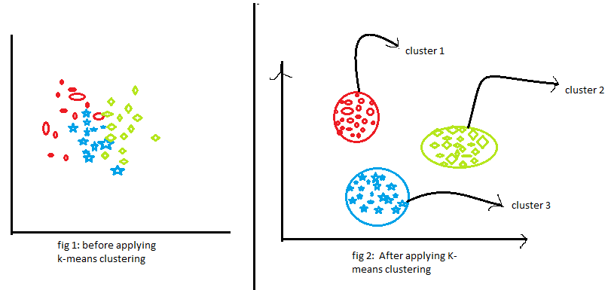
Un – supervised learning

Slide 79

Un – supervised learning

Slide 80
Un – supervised learning
K-Means algorithm is the process of dividing the N data points into K groups or clusters.
Here the steps of the algorithm are:
1. Start by choosing K random points the initial cluster centers.
2. Assign each data point to their nearest cluster center. The most common way of measuring the distance between the points is the Euclidean distance.
3. For each cluster, compute the new cluster center which will be the mean of all cluster members.
4. Now re-assign all the data points to the different clusters by taking into account the new cluster centers.
5. Keep iterating through the step 3 & 4 until there are no further changes possible. At this point, you arrive at the optimal clusters.

Slide 81
Un – supervised learning
Points to be considered while implementing the K-Means algorithm are:
How to choose the value of "K number of clusters" in K-means Clustering?
The performance of the K-means clustering algorithm depends upon the highly efficient clusters that it forms.
But choosing the optimal number of clusters is a big task. There are some different ways to find the optimal number of clusters, but here we are discussing the most appropriate method to find the number of clusters or value of Elbow Method.
The Elbow method is one of the most popular ways to find the optimal number of clusters. This method uses the concept of WCSS value.
WCSS stands for Within Cluster Sum of Squares, which defines the total variations within a cluster.
WCSS= ∑Pi in Cluster1 distance(Pi C1)2 +∑Pi in Cluster2distance(Pi C2)2+∑Pi in CLuster3 distance(Pi C3)2

Slide 82
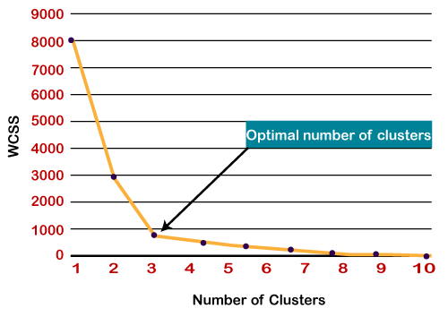
Un – supervised learning
To find the optimal value of clusters, the Elbow method follows the below steps:
It executes the K-means clustering on a given dataset for different K values (ranges from 1-10).
For each value of K, calculates the WCSS value. Plots a curve between calculated WCSS values and the number of clusters K.
The sharp point of bend or a point of the plot looks like an arm, then that point is considered as the best value of K.
Since the graph shows the sharp bend, which looks like an elbow, hence it is known as the elbow method.

Slide 83
Un – supervised learning
The optimum number of clusters(elbow method):
The basic idea is to start with multiple clusters k= 1,2,3,4,5... create multiple clusters.at a point adding a cluster does not seem beneficial, we can stop at that point.
SSD=[]
range_of_clusters = [2,3,4,5,6,7,8]
for each_n_every_clus in range_of_clusters:
#first let's do clustering
#instantiate the object
kmeans=KMeans(n_clusters=each_n_every_clus, max_iter = 50)
#now I can fit a k-means
kmeans.fit(new_final)
SSD.append(kmeans.inertia_)
#plot SSD for clusters.
plt.plot(SSD)
#ssd
plt.title('the elbow graph')
plt.xlabel('number of clusters')
plt.ylabel('SSD)
plt.show()

Slide 84
Un – supervised learning
Training the K-means algorithm on the training dataset:
As we have got the number of clusters, so we can now train the model on the dataset.
training the K-means model on a dataset.
kmeans = KMeans(n_clusters=5, init='k-means++', random_state= 42)
y_predict= kmeans.fit_predict(ssd)
We can now compare the values of y_predict with our original dataset.
Visualizing the Clusters:
The last step is to visualize the clusters. As we have 5 clusters for our model, so we will visualize each cluster one by one.

Slide 85
Un – supervised learning
Applications of K-Means Clustering:
K-Means clustering is used in a variety of examples or business cases in real life, like:
Diagnostic systems: The medical profession uses k-means in creating smarter medical decision support systems, especially in the treatment of liver ailments.
Search engines: Clustering forms the backbone of search engines. When a search is performed, the search results need to be grouped, and the search engines very often use clustering to do this.
Wireless sensor networks : The clustering algorithm plays the role of finding the cluster heads, which collect all the data in its respective cluster.

Slide 86
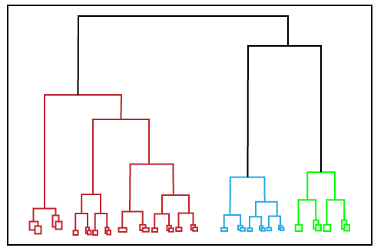
Un – supervised learning
Hierarchical Clustering:
Another algorithm to achieve unsupervised clustering. This is called Hierarchical Clustering. Here, instead of pre-defining the number of clusters, you first have to visually describe the similarity or dissimilarity between the different data points and then decide the appropriate number of clusters based on these similarities or dissimilarities.
one of the major considerations in using the K-means algorithm is deciding the value of K beforehand. The hierarchical clustering algorithm does not have this restriction.
The output of the hierarchical clustering algorithm is quite different from the K-mean algorithm as well. It results in an inverted tree-shaped structure, called the dendrogram.

Slide 87
Un – supervised learning
In hierarchical clustering a series of partitions/merges take place, which may run from a single cluster containing all objects to n clusters that each contain a single object or vice-versa. This is very helpful since you don’t have to specify the number of clusters beforehand.
Given a set of N items to be clustered, the steps in hierarchical clustering are:
Calculate the NxN distance (similarity) matrix, which calculates the distance of each data point from the other.
Each item is first assigned to its cluster, i.e., N clusters are formed.
The clusters which are closest to each other are merged to form a single cluster.
The same step of computing the distance and merging the closest clusters is repeated till all the points become part of a single cluster.
Thus, what you have at the end is the dendrogram.

Slide 88
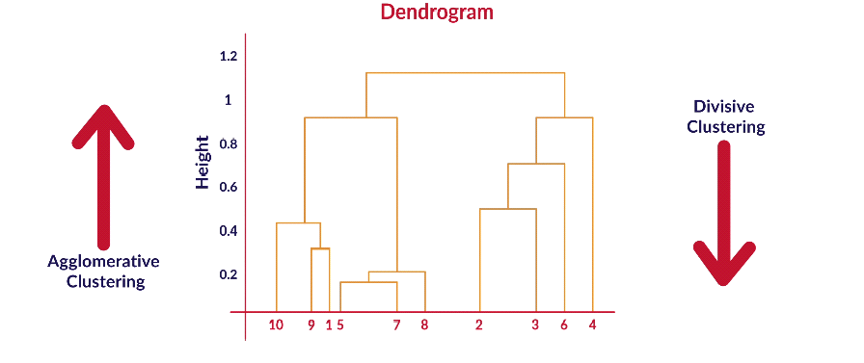
Un – supervised learning
hierarchical clustering can proceed in 2 ways — agglomerative and divisive. If you start with n distinct clusters and iteratively reach a point where you have only 1 cluster, in the end, it is called agglomerative clustering. On the other hand, if you start with 1 big cluster and subsequently keep on partitioning this cluster to reach n clusters, each containing 1 element, it is called divisive clustering.

Slide 89
Un – supervised learning
Finding the optimal number of clusters using the Dendrogram:
Now we will find the optimal number of clusters using the Dendrogram for our model. For this, we are going to use the SciPy library as it provides a function that will directly return the dendrogram for our code.
import scipy.cluster.hierarchy as shc
dendro = shc.dendrogram(shc.linkage(x, method="ward"))
mtp.title("Dendrogrma Plot")
mtp.ylabel("Euclidean Distances")
mtp.xlabel("Customers")
mtp.show()
In the above lines of code, we have imported the hierarchy module of the SciPy library. This module provides us with a method shc. dendrogram(), which takes the linkage() as a parameter.
The linkage function is used to define the distance between two clusters, so here we have passed the x(matrix of features), and method "ward," the popular method of linkage in hierarchical clustering.

Slide 90
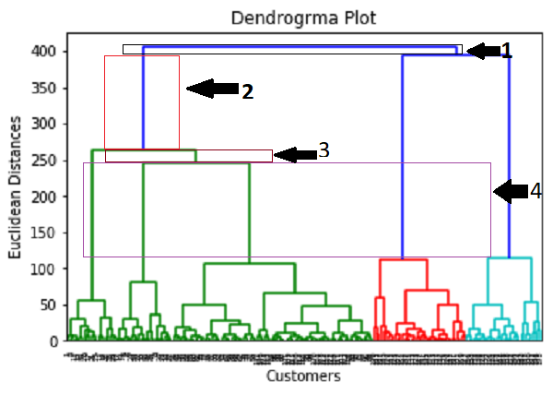
Un – supervised learning
Using this Dendrogram, we will now determine the optimal number of clusters for our model. For this, we will find the maximum vertical distance that does not cut any horizontal bar.
In the diagram, we have shown the vertical distances that are not cutting their horizontal bars. As we can visualize, the 4th distance is looking the maximum, so according to this, the number of clusters will be 5(the vertical lines in this range).
So, the optimal number of clusters will be 5, and we will train the model in the next step, using the same.

Slide 91
Un – supervised learning
Training the hierarchical clustering model: As we know the required optimal number of clusters, we can now train our model.
from sklearn.cluster import AgglomerativeClustering
hc= AgglomerativeClustering(n_clusters=5, affinity=‘Euclidean', linkage='ward')
y_pred= hc.fit_predict(x)
The AgglomerativeClustering class takes the following parameters:
n_clusters=5: It defines the number of clusters, and we have taken here 5 because it is the optimal number of clusters.
affinity=‘Euclidean': It is a metric used to compute the linkage.
linkage='ward': It defines the linkage criteria, here we have used the "ward" linkage. This method is the popular linkage method that we have already used for creating the Dendrogram. It reduces the variance in each cluster.
In the last line, we have created the dependent variable y_pred to fit or train the model. It does train not only the model but also returns the clusters to which each data point belongs.

Slide 92
Un – supervised learning
Principal Component Analysis : is an unsupervised learning algorithm that is used for dimensionality reduction in machine learning.
In simplest terms, PCA is such a feature extraction method where we create new independent features from the old features and from a combination of both while keeping only those features that are most important in predicting the target.
New features are extracted from old features and any feature can be dropped that is considered to be less dependent on the target variable.
All the features that are created are independent of each other. These new transformed features are called the Principal Components.
It is one of the popular tools that is used for exploratory data analysis and predictive modelling. It is a technique to draw strong patterns from the given dataset by reducing the variances.

Slide 93
Un – supervised learning
Principal Component Analysis: Principal component analysis, or PCA, is a dimensionality reduction method that is used to diminish the dimensionality of large datasets by converting a huge quantity of variables into a small one and keeping most of the information preserved.
The PCA algorithm is based on some mathematical concepts such as: Variance and Covariance, Eigenvalues and Eigen factors.
Some common terms used in PCA algorithm:
Dimensionality: It is the number of features or variables present in the given dataset. More easily, it is the number of columns present in the dataset.
Eigenvectors: If there is a square matrix M, and a non-zero vector v is given. Then v will be eigenvector if Av is the scalar multiple of v.
Covariance Matrix: A matrix containing the covariance between the pair of variables is called the Covariance Matrix.

Slide 94
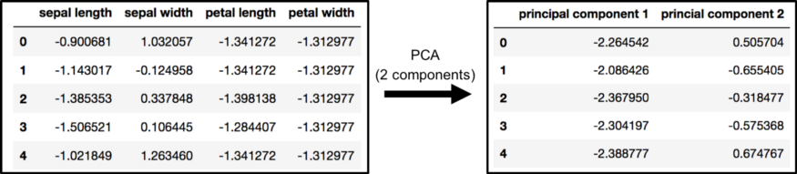
Un – supervised learning
Normalization of data is very necessary to apply PCA. Unscaled data can cause problems in the relative comparison of the dataset.
Code:
from sklearn.decomposition import PCA
pca = PCA(n_components=2)
principalComponents = pca.fit_transform(x)
principalDf = pd.DataFrame(data = principalComponents , columns = ['principal component 1', 'principal component 2'])
finalDf = pd.concat([principalDf, df[['target']]], axis = 1)

Slide 95
Un – supervised learning
When to Use PCA?
﻿Case:1 When you want to lower down the number of variables, but you are unable to identify which variable you don't want to keep in consideration.
Case:2 When you want to check if the variables are independent of each other.
Principal Component Analysis Mechanism
Steps for PCA
Initially start with standardization of data.
Create a correlation matrix or covariance matrix for all the desired dimensions.
Calculate eigenvectors that are the principal component and respective eigenvalues that apprehend the magnitude of variance.
Arrange the eigenpairs in decreasing order of respective eigenvalues and pick the value which has the maximum value, this is the first principal component that protects the maximum information from the original data.

Slide 96
Un – supervised learning
Advantages of PCA:
PCA improves the performance of the ML algorithm as it eliminates correlated variables.
PCA helps in overcoming data overfitting issues by decreasing the number of features.
Reduction of noise since the maximum variation basis is chosen and so the small variations in the background are ignored automatically.
Disadvantages of PCA:
It is difficult to evaluate the covariance in a proper way.
Data needs to be standardized before implementing PCA else it becomes difficult to identify optimal principal components.
Though PCA covers maximum variance amid data features, sometimes it may skip a bit of information in comparison to the actual list of features.

Slide 97
Un – supervised learning
Applications of PCA: Data is generated in many sectors, and there is a need to analyze data for the growth of any firm/company. PCA will help in reducing the dimensions of the data, thus making it easier to analyze.
The applications of PCA are:
PCA is mainly used as the dimensionality reduction technique in various AI applications such as computer vision, image compression, etc.
It can also be used for finding hidden patterns if data has high dimensions. Some fields where PCA is used are Finance, data mining, medical, etc.
Finance – PCA is used in the finance sector for reducing the dimensionality of data to create fixed income portfolios.
Medical – PCA is used on a lot of medical data to find the correlation among different variables. For example, doctors use PCA to show the correlation between cholesterol & low-density lipoprotein.

Slide 98

Thank you

